Slide 1
ArXiv Recommendation System
- Udip Bohara

Slide 2
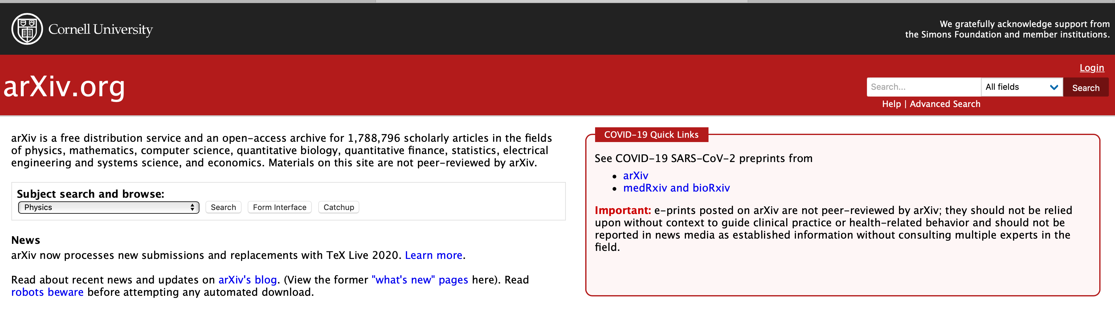
Objectives
arXiv is a free distribution service and an open-access archive for 1,788,796 scholarly articles in the fields of physics, mathematics, computer science, quantitative biology, quantitative finance, statistics, electrical engineering and systems science, and economics.
Network Analysis (transferable to other domains)
Recommendation/Database system that leverages multiple concepts for efficient and effective querying.
Robust system.
Build a database that empowers recommendation leveraging NLP and Graph Systems.

Slide 3
Steps
Data Collection
Citation Network
Topic Modeling
Similarities
Graph Modeling
Tech used: PySpark (in Google Cloud Platform), Google Colab, Python, Neo4j, Gephi, Kaggle

Slide 4
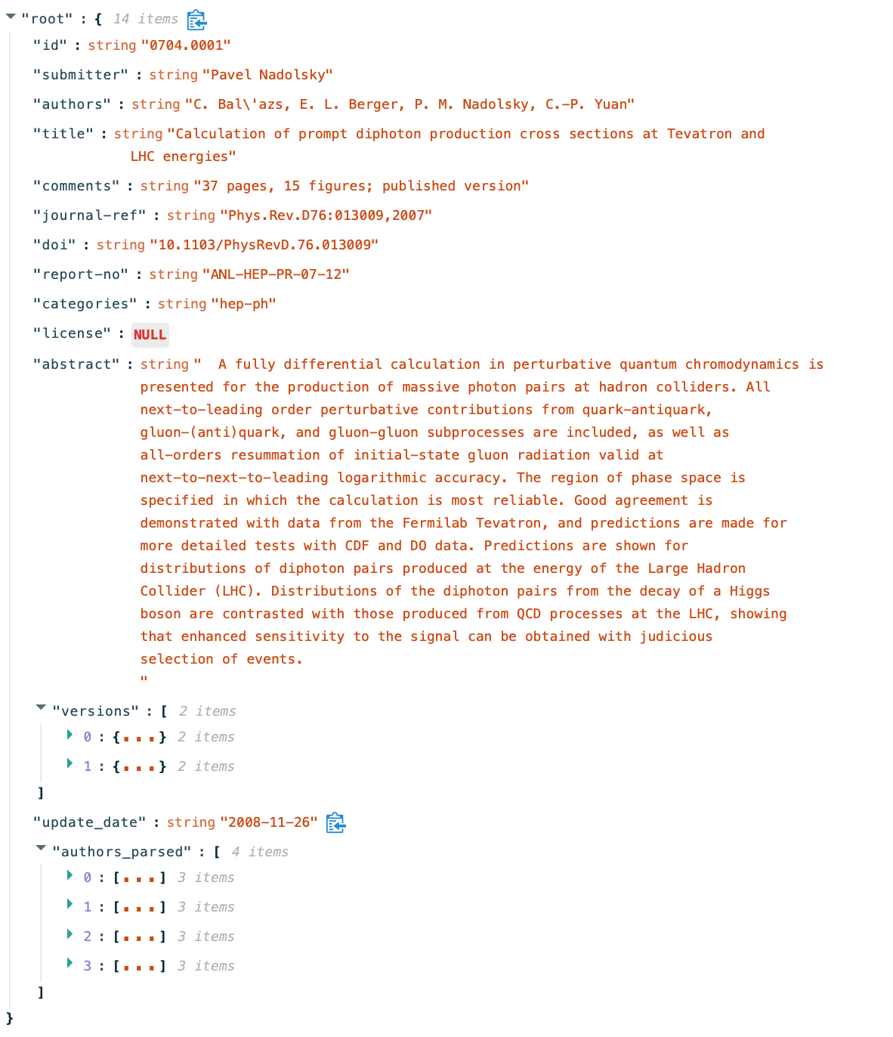
Data Collection

Slide 5
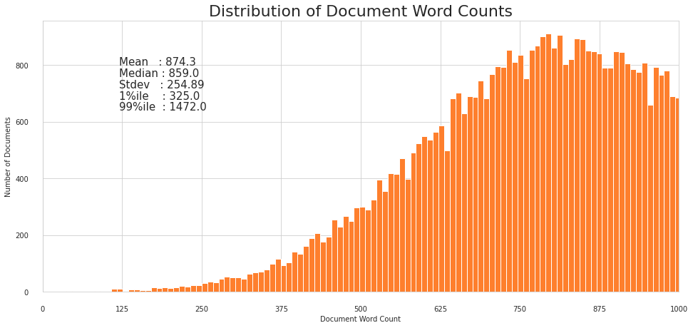
At the time of the when this project was started 1,747,307 papers were present in it.
‘Artificial Intelligence’, ‘Machine Learning’ and ‘Computer Vision and Pattern Recognition’ were selected corresponding to their respective tags/categories defined in ArXiv system.
61425 papers (>= 2018) were extracted.

Slide 6
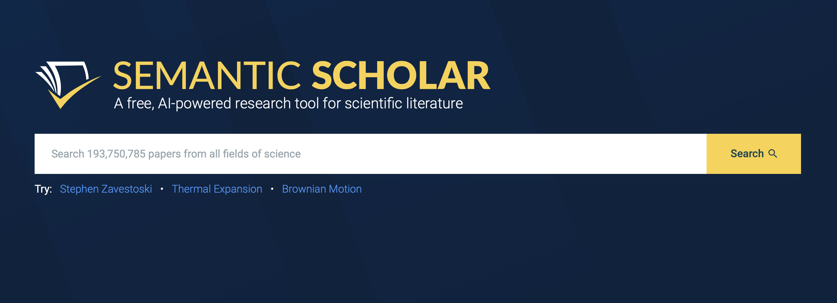
Citation Network
The citation was extracted from Semantic Scholar API using batches

Slide 7
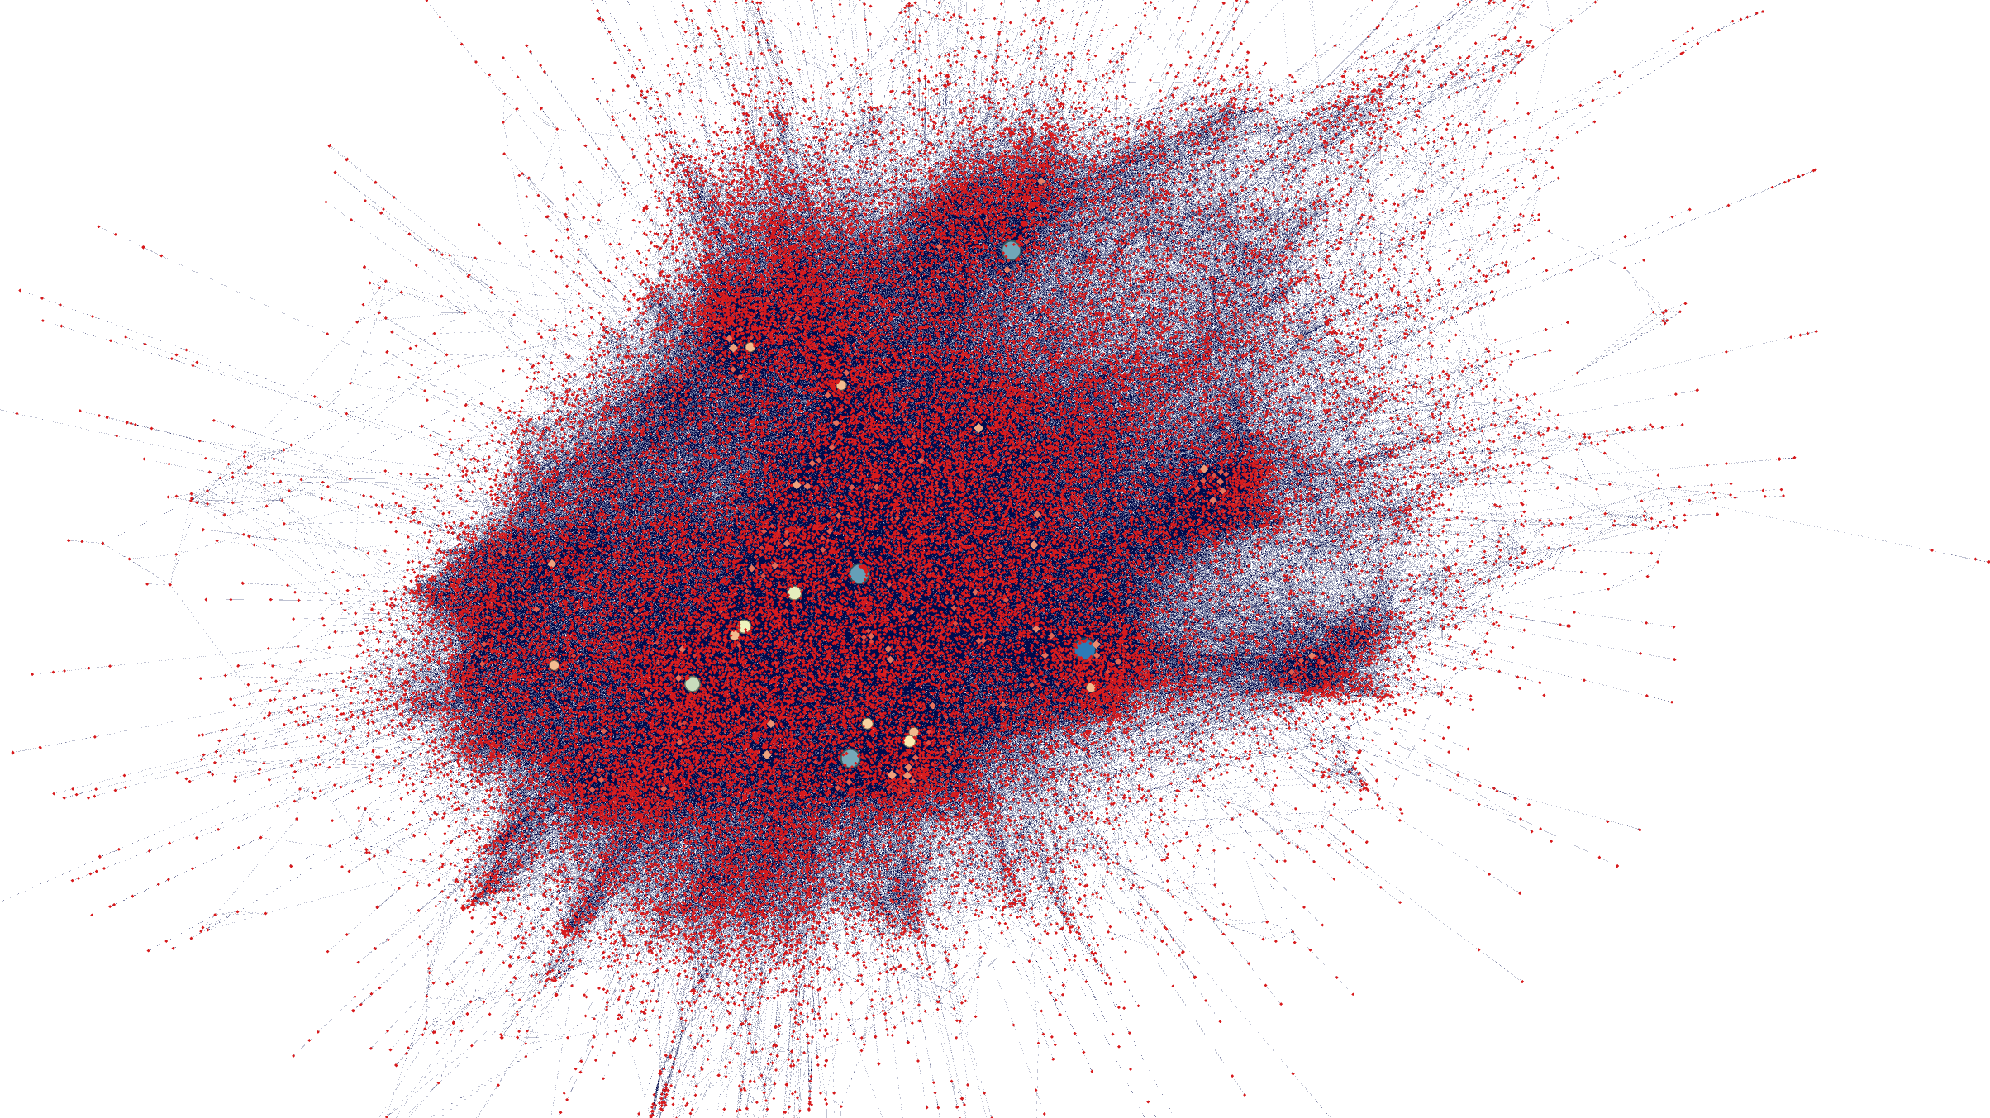
Citation Network Visualized

Slide 8
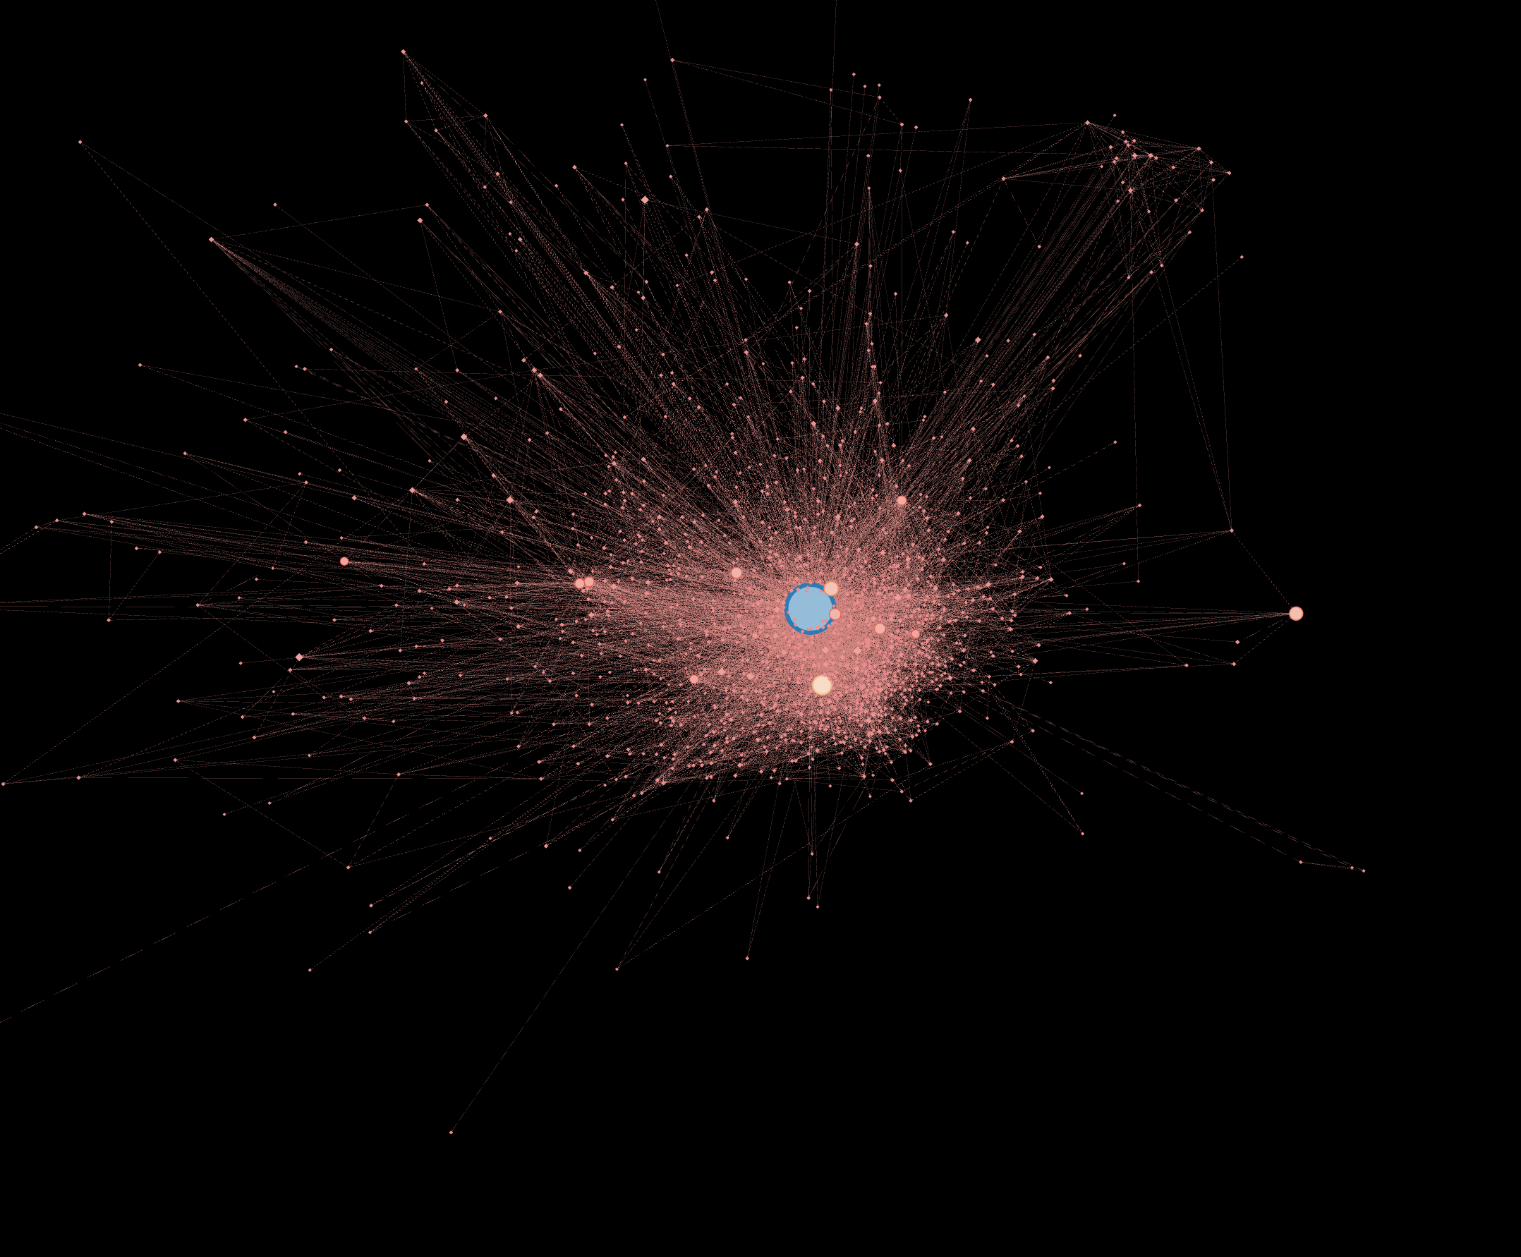
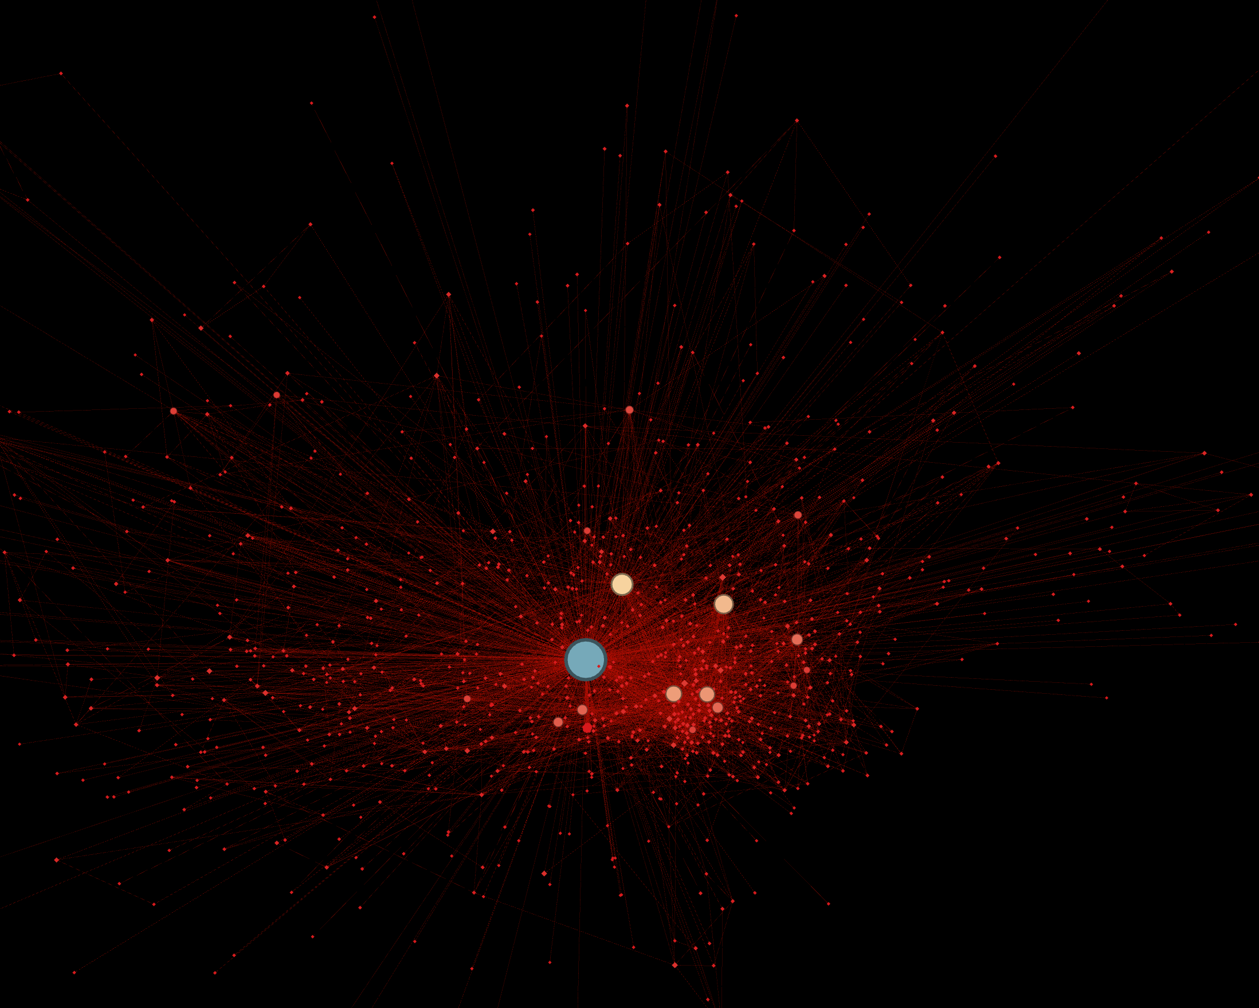
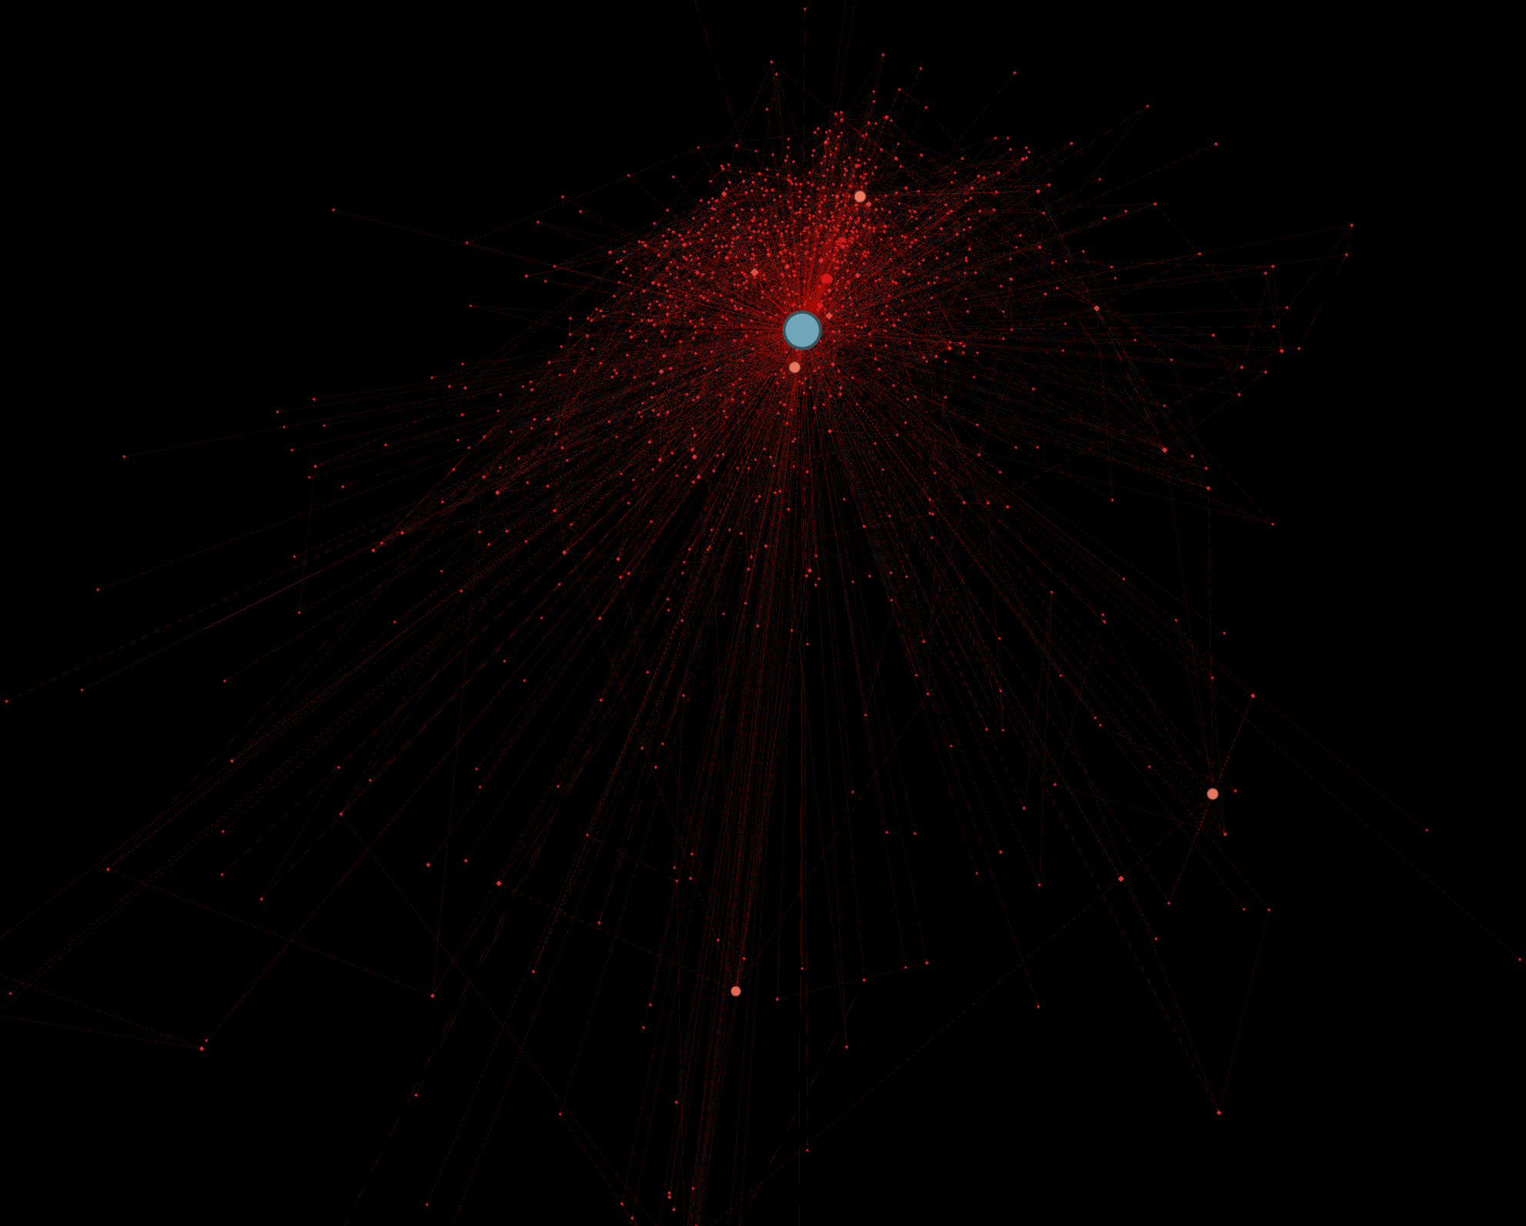
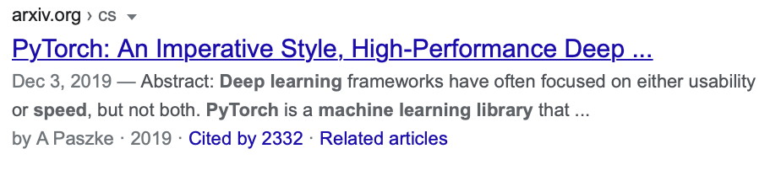
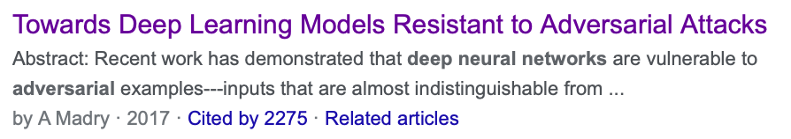
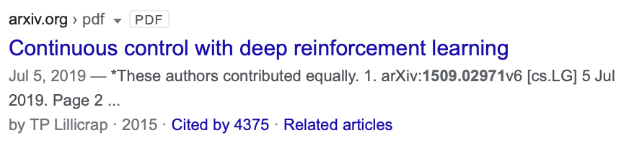
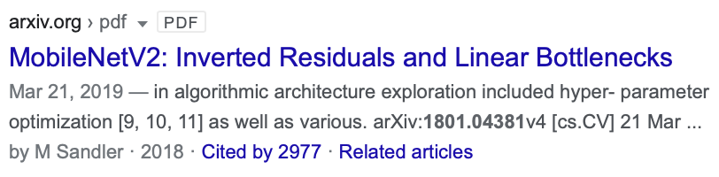

Slide 9
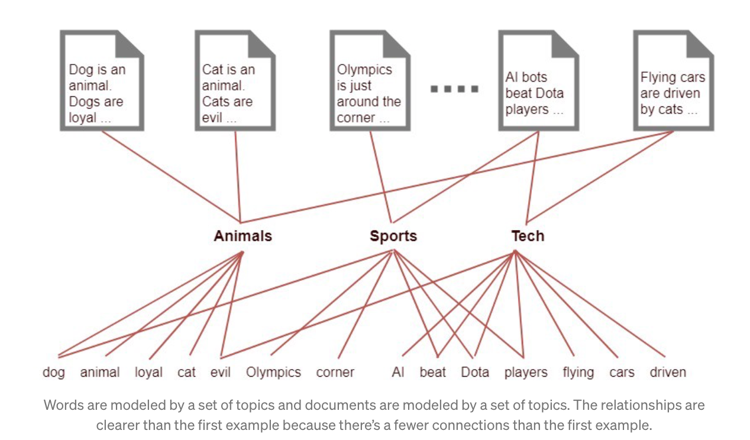
Topic Modeling

Slide 10
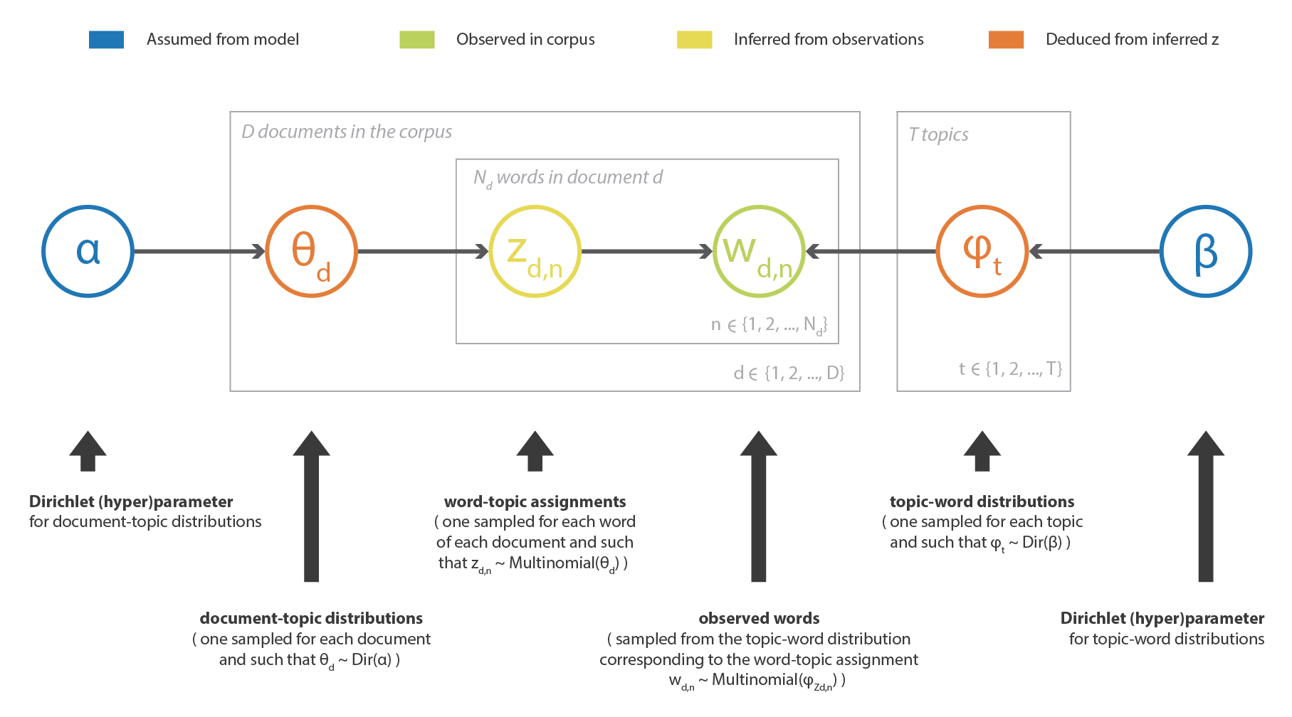
Latent Dirichlet allocation
LDA is a generative probabilistic model that assumes each topic is a mixture over an underlying set of words, and each document is a mixture of over a set of topic probabilities. Each document can be described by a distribution of topics and each topic can be described by a ditribution of words

Slide 11
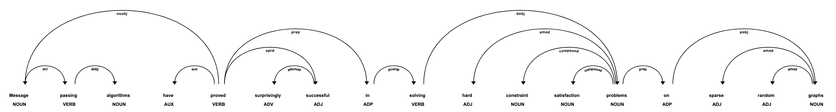
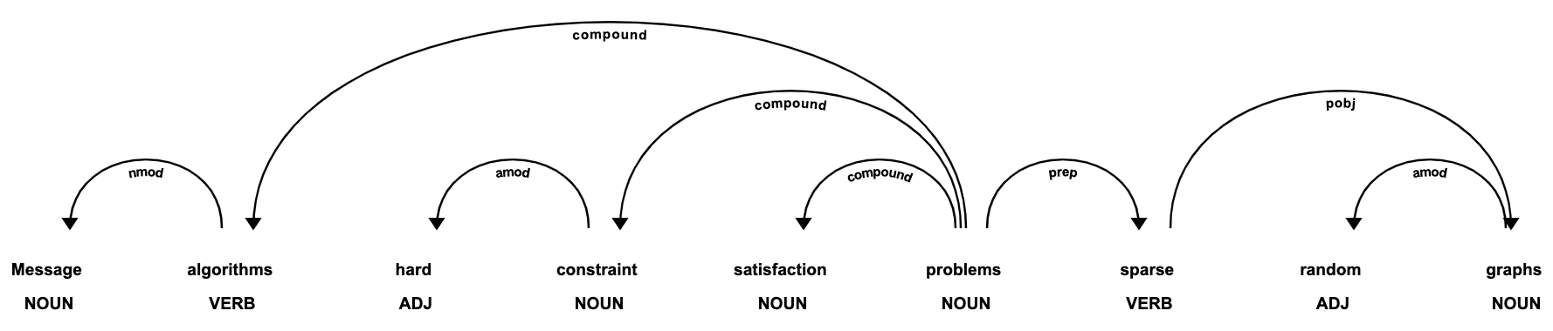
PART-OF-SPEECH (POS)
‘Message passing algorithm have proved surprisingly successful in solving hard constraint satisfaction problems on sparse random graphs.”
Extracted Noun Phrases

Slide 12
Adding Bigrams and Tri-grams
(b'constraint', b'satisfaction') (b'belief', b'propagation') (b'propagation', b'bp') (b'copula', b'entropy') (b'aesthetically', b'pleasing') (b'randomly', b'generated') (b'partial', b'observability') (b'partially', b'observable') (b'observable', b'markov') (b'markov', b'decision')

Slide 13
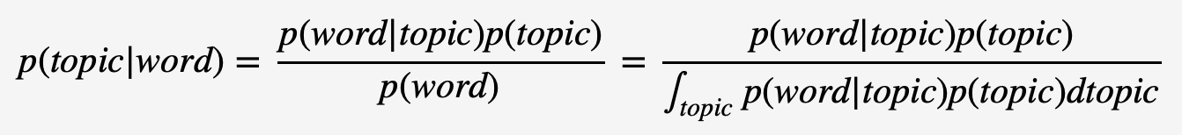
Mallet Vs GENSIM MALLET

Slide 14
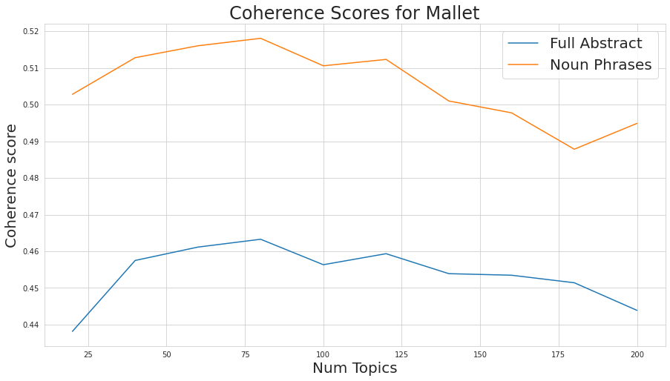
TopiC Coherence

Slide 15
Visualization of TopicS
with a higher alpha, documents are assumed to be made up of more topics and result in more specific topic distribution per document.

Slide 16
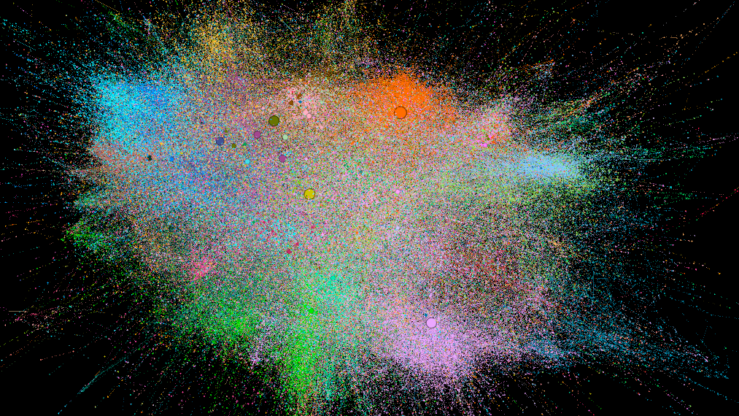

Slide 17
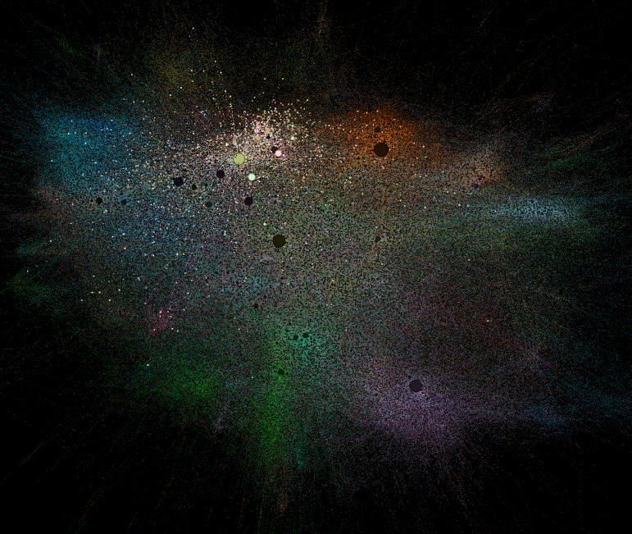
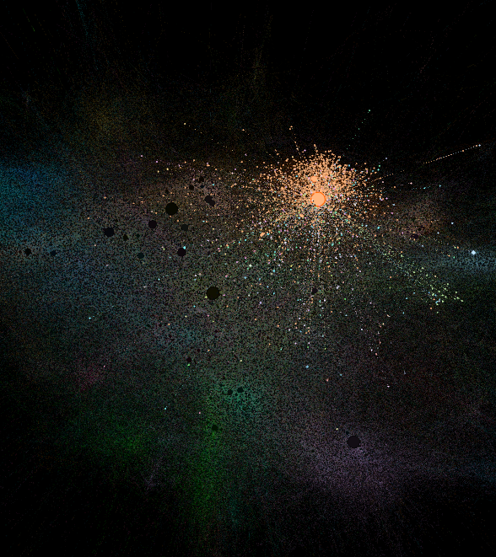
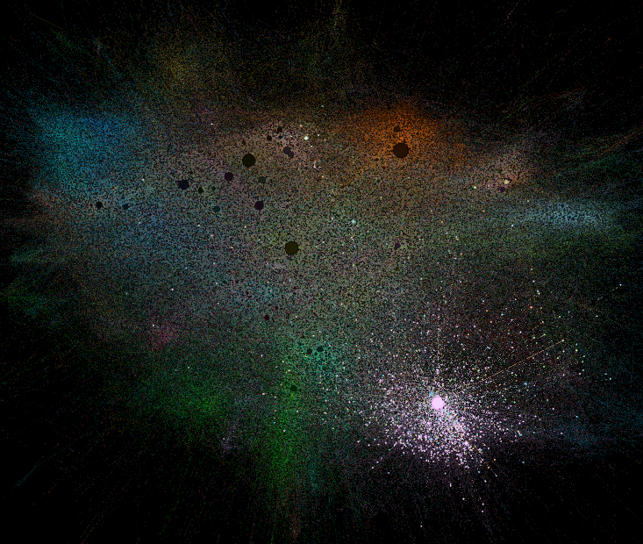
Most Influential Papers for the Topics Highlighted in the Network

Slide 18
Semantic SIMILARITIES USING BERT TRANSFORMERS
BERT (Bidirectional Encoder Representations from Transformers) makes use of Transformer, an attention mechanism that learns contextual relations between words (or sub-words) in a text.
An encoder that reads the text input and a decoder that produces a prediction for the task

Slide 19
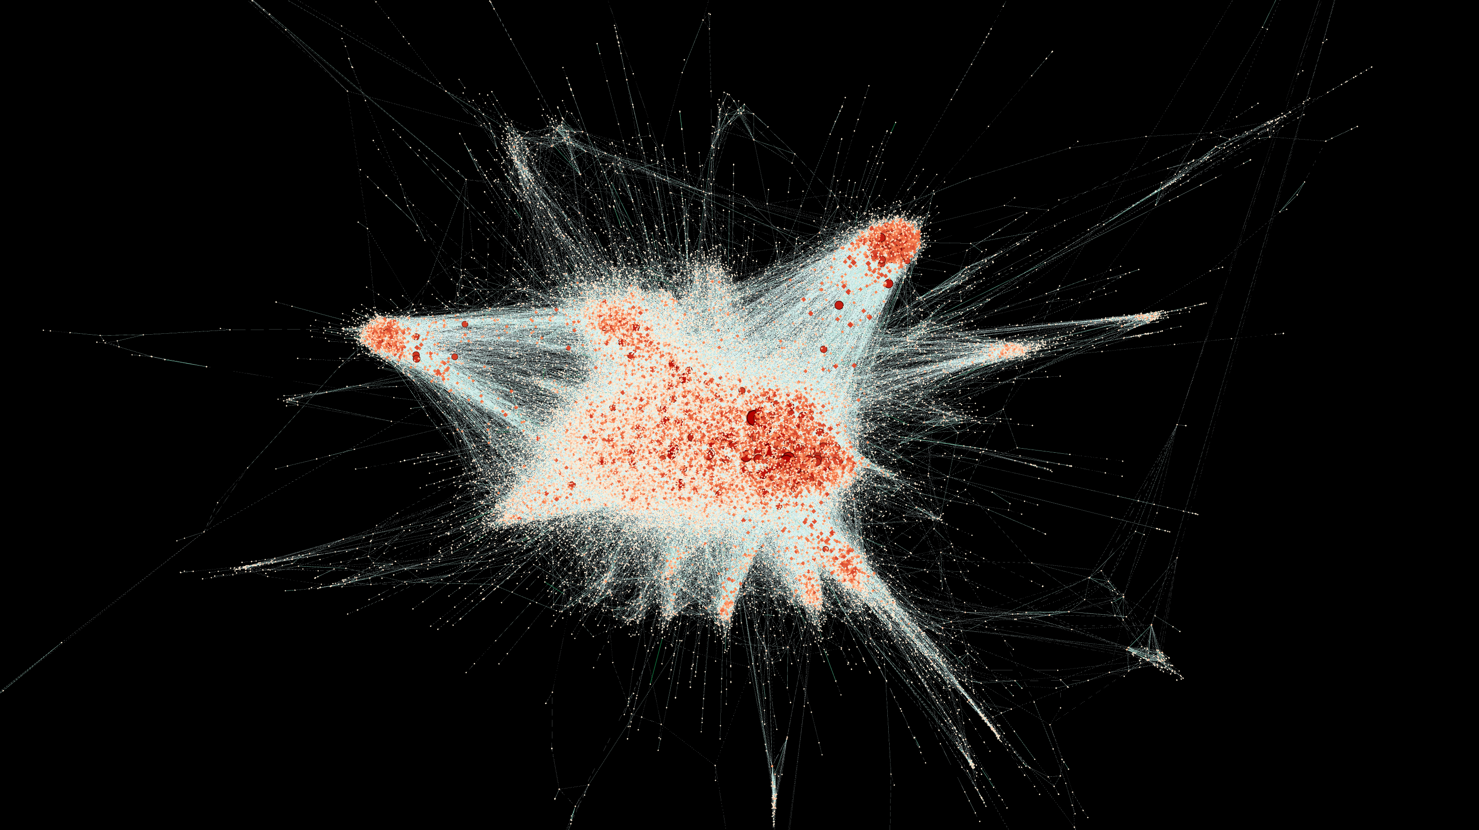
Similarities Network

Slide 20
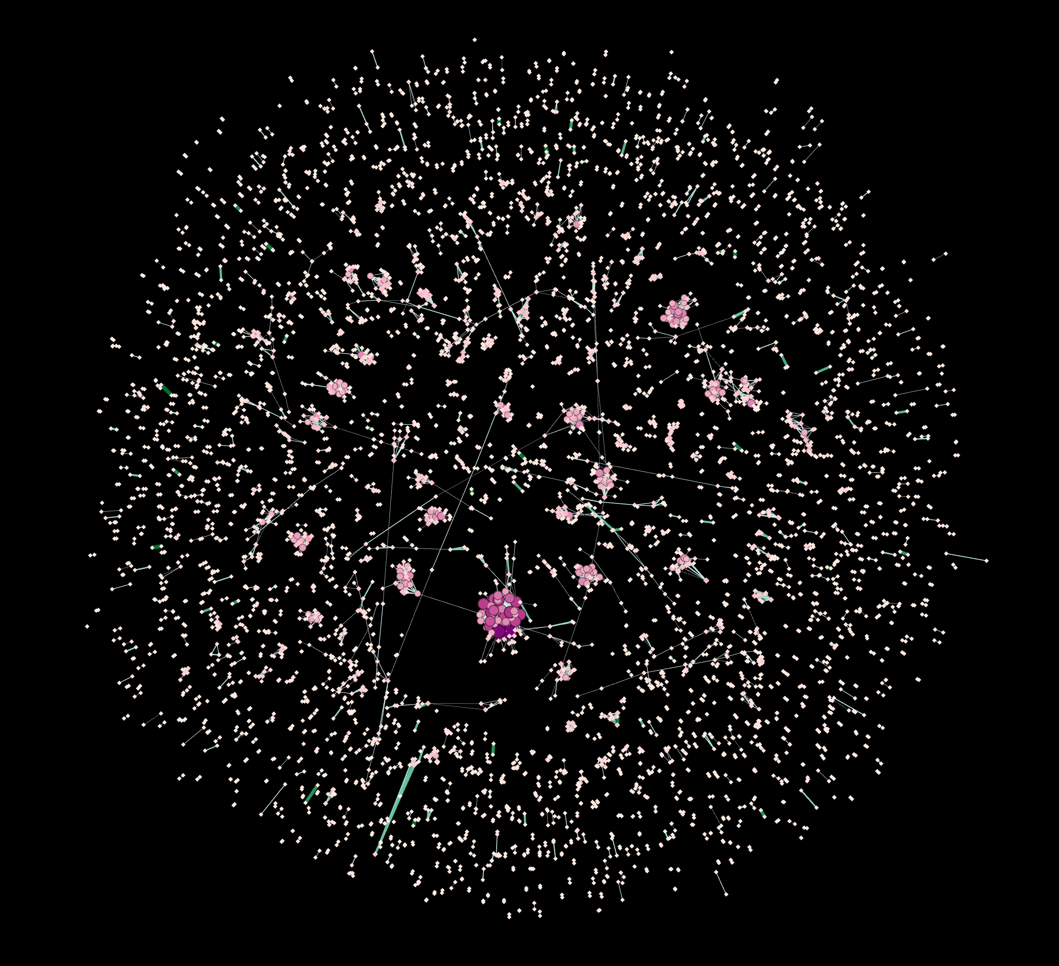
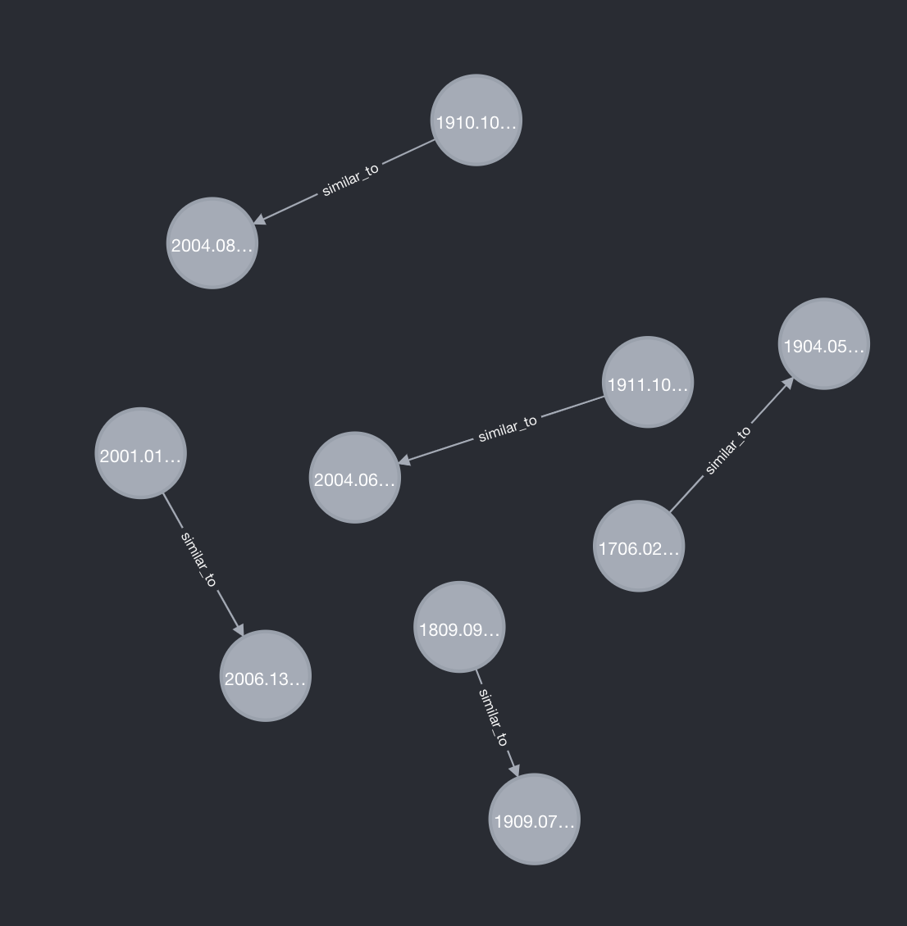
ID-IDF COSINE SIMILARITY (6500 docs Threshold 0.5)

Slide 21
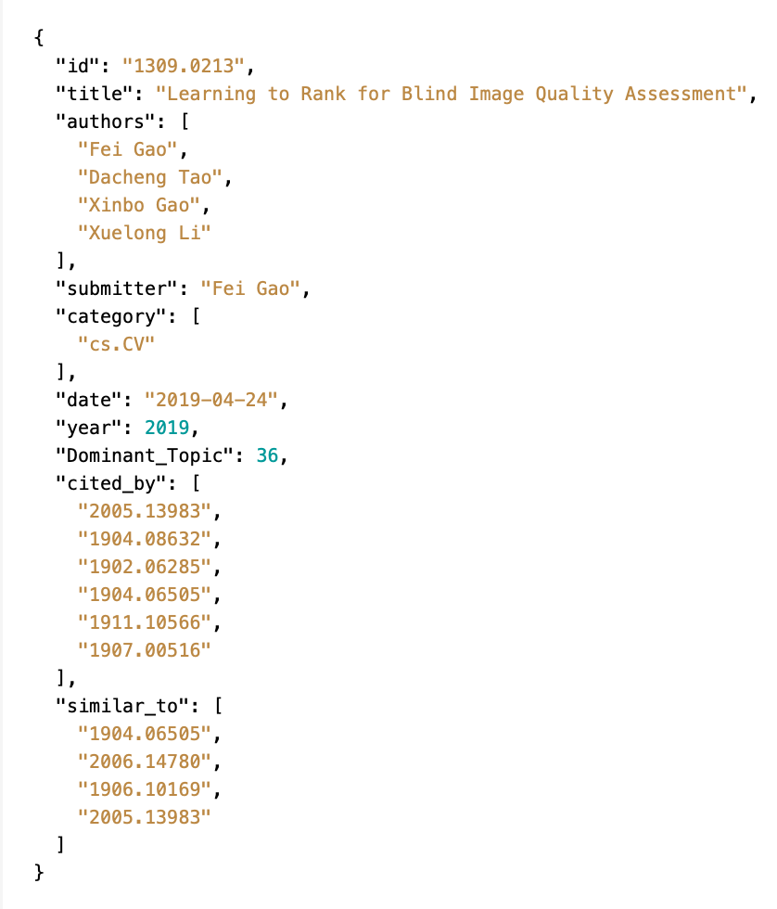
DataBASE MODELING

Slide 22
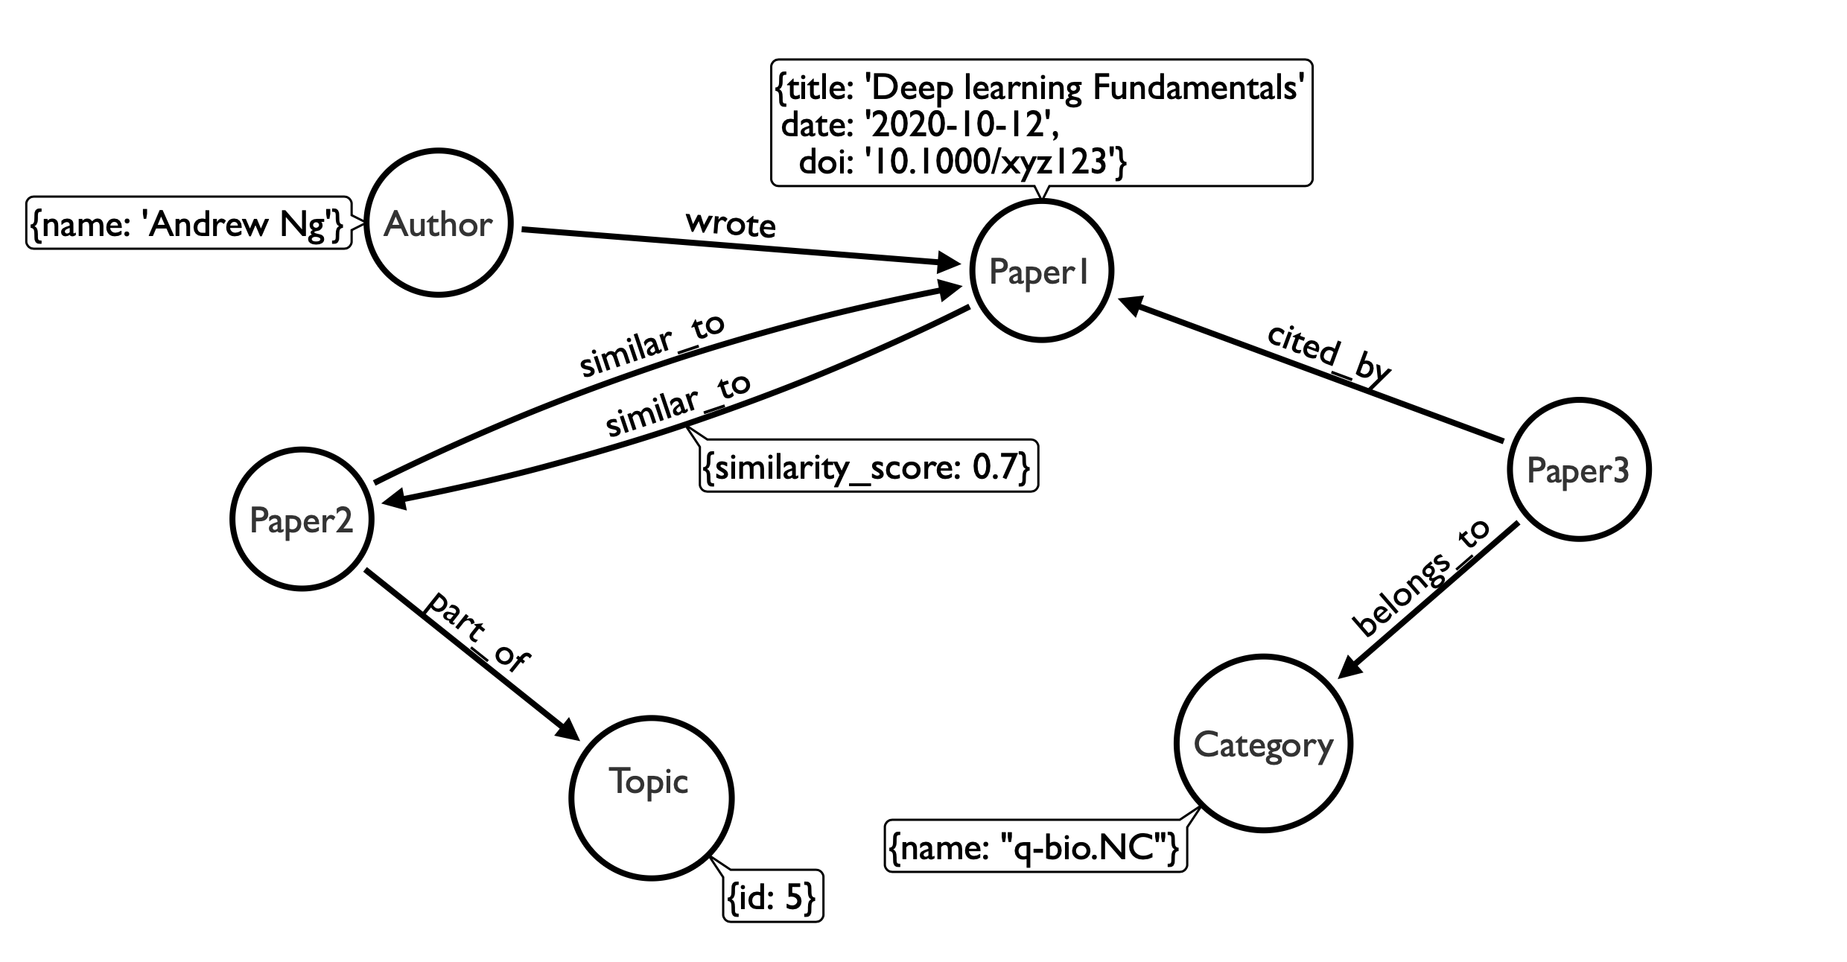
SCHEMA

Slide 23
NEO4j

Slide 24
Questions?

